Slide 1
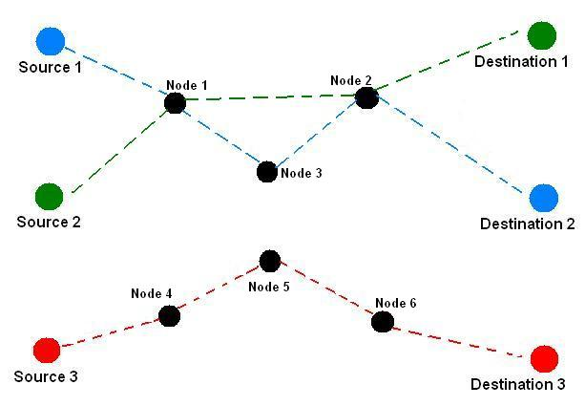
Packet and Circuit Switching

Slide 2
Switching
In any digital communication, there must be a sender and receiver with a connection between them.
Two methods commonly used to send data over a network which has multiple paths are:
Circuit switching
Packet switching
Switching sends data along the appropriate path and prevents all data being sent to all parts of the network.
It is more efficient not to send data where it is not required

Slide 3
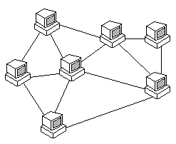
Making a connection
It is not always possible to make a direct connection between the sender and receiver.
When you connect to a website on the Internet a connection is made between your device and the device hosting the website, but this is routed through various other nodes.
This means that there are a vast number of routes that data can take in order to reach it’s destination.

Slide 4
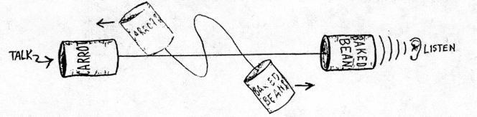
Circuit switching
Consider a telephone network.
When an individual makes a telephone call to someone else a connection is made between the two nodes (telephones).
This connection stays open until the call has finished and blocks anyone else from using the line.

Slide 5
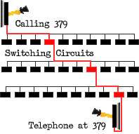
Circuit Switching
On a digital network, a connection is made between two nodes but can go through any number of other nodes.
A path is reserved between the two computers for the duration of the transmission
No other data can use any part of this circuit until the transmission is complete
Data is divided into packets of equal size which are sent down the circuit in the correct order

Slide 6
Circuit Switching
Advantages:
Communication can occur at any time without waiting for a connection delay
Data arrives in the same order that it is sent
Disadvantages:
Bandwidth is wasted if no communication takes place
Only connects devices with the same transfer rate

Slide 7
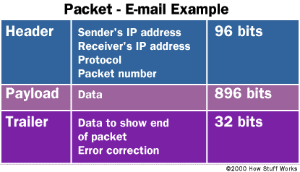
Packet Switching
Packet switching involves breaking the message into smaller parts (packets).
A packet is a complete self-contained chunk of data that contains enough routing information for it to reach its destination.
Each packet has a header which contains important information such as:
Source IP address
Destination IP address
Packet number – so that the message can be reassembled

Slide 8
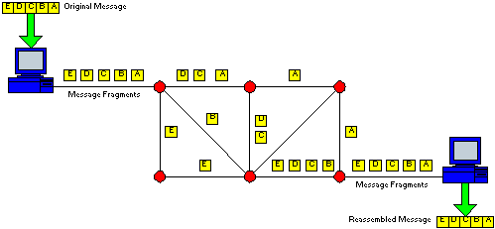
Packet Switching
Data is split into equal sized blocks (called packets)
Each packet has a header of information
Each packet is placed on the network and each may travel by a different route
At each node on the network the destination address is read and the best route is found (least busy path)
Packets need to be reordered at the destination

Slide 9
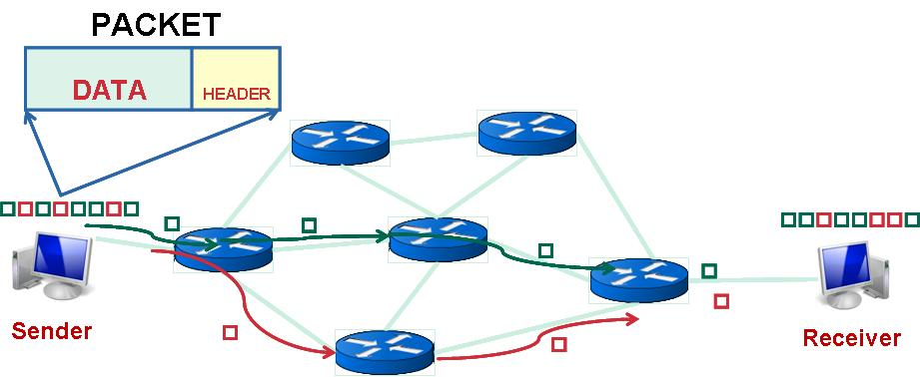
Packet Switching - Advantages
It makes very efficient use of the network - no tied-up lines.
It is easy to avoid broken bits of the network.
As the numbers of users increases, the network only has to expand slowly compared to circuit switching

Slide 10
Packet Switching - Disadvantages
Sometimes packets can get lost and keep bouncing around from router to router, never quite getting to their destination.
It can take a long time to put the data back together which can be a problem for time-critical information such as an emergency signal. This is known as 'latency'.

Slide 11
Circuit Switching V Packet Switching
Circuit Switching | Packet Switching
establishes a route for the duration of the message | has no established route
sends packets all on same route | packets sent on individual routes
message can be intercepted if route can be tapped into | more secure because packets all use different routes
packets remain in correct order (but must be reassembled) | packets arrive out of order (and must be reordered)
ties up large areas of the network for duration of message | maximises use of network

Slide 12
Circuit Switching V Packet Switching
Packet switching preferred because:
Transmission is safer from interception because it is impossible to intercept all the packets as they use different routes
Very efficient use of network as each channel only used for short time which does not tie up a part of the network
If there is an error then only a small, identifiable, part of the data is affected, which can be retransmitted easily

Slide 13
Routing
Transmissions will be routed through a number of nodes before a connection is established.
A router will be used to send the data to the appropriate node.
It knows where to send the data, as it extracts the address from the header of each packet being sent.
Routing will find the fastest path from sender to receiver by forwarding the data to next “best” node in the route.
This can be achieved by using a routing table and routing algorithm.

Slide 14
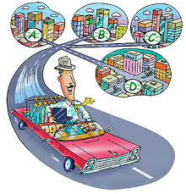
Routing Tables
The routing table stores information about the different paths along which data can be sent.
These tables are constructed in the memory of network components such as routers and gateways.
Each router knows the information about it’s closest neighbours, but by sharing this information it is possible to determine the fastest route.

Slide 15
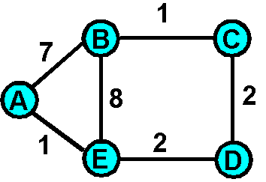
Routing Table Example
E.g. to get to Node D from Node A
Start Node | End Node | Cost
A | B | 7
A | E | 1
B | C | 1
B | E | 8
C | D | 2
E | D | 2
Start Node | End Node | Route Via | Cost
A | D | B,C | 10
A | D | B,E | 17
A | D | E | 3

